Slide 1
Emotional Expressions Reconsidered
Challenges to inferring emotion from human facial movements
Graduate seminar in affective computing | 1 hour 20 minutes
Barrett, Adolphs, Marsella, Martinez, & Pollak (2019)
Central question: when can a face-to-emotion inference be valid?
Notes:
Opening - 1 minute. Frame the paper as a direct challenge to a familiar assumption in affective computing: that faces are readouts of emotions. Tell students the goal is not to deny that faces matter, but to ask what kind of evidence justifies which computational claims.

Slide 2
LEARNING GOALS
What students should be able to do
Distinguish facial movement detection from emotion inference.
Seminar stance
The face is informative, but not a diagnostic fingerprint of emotion in isolation.
Explain reliability, specificity, generalizability, and validity.
Evaluate evidence from production and perception studies.
Translate the critique into dataset, model, and deployment choices.
Affective computing question
What should our systems predict: emotion labels, facial actions, appraisals, social signals, or future behavior?
Barrett et al. (2019) | Affective computing seminar
2
Notes:
Timing: 2 minutes. Use this slide to set evaluation criteria for the seminar. Emphasize that the paper is translational: it addresses consumers of emotion research, including AI and computer vision researchers.

Slide 3
ROADMAP
80-minute seminar arc
0-10
10-25
25-45
45-60
60-72
72-80
Problem
Concepts
Production
Perception
Computing
Discussion
Why facial emotion inference matters
Common view, reverse inference, criteria
How people actually move their faces
How observers infer meaning
Datasets, models, evaluation, deployment
Audit a face-emotion classifier
Suggested interaction pattern: invite brief predictions before each evidence block, then revisit them after the data.
Barrett et al. (2019) | Affective computing seminar
3
Notes:
Timing: 2 minutes. Give students the map. Emphasize that the seminar has one core argument and two evidence blocks. You can cut slides in each block if discussion runs long.

Slide 4
MOTIVATION
Opening hook: what does a smile prove?
Face seen by a system
happiness
0.91
decision
/ action
But what else could it mean?
social affiliation
task demand
politeness
posed expression
submission
pain
masking
embarrassment
camera prompt
habit
cultural convention
actual joy
Barrett et al. (2019) | Affective computing seminar
4
Notes:
Timing: 3 minutes. Ask the room: what are all the reasons someone might smile? Let them generate alternatives. Then introduce the paper as an argument that face-only emotion inference is a reverse inference with many possible causes.

Slide 5
MOTIVATION
Why this matters in affective computing
Commercial
interfaces
Education
& training
Clinical
assessment
Security
& law
The same technical error can become a social error:
Treating a label as ground truth when it is only human consensus.
Treating above-chance performance as deployment-ready accuracy.
Treating a static, isolated face as a complete social situation.
Barrett et al. (2019) | Affective computing seminar
5
Notes:
Timing: 2 minutes. Connect the paper to affective computing domains students know. The key warning: a technical pipeline can be mathematically sophisticated while its target variable is under-justified.

Slide 6
CORE ASSUMPTION
The common view: one face, one emotion
anger
sadness
happiness
fear
reliable cause
scowl
frown
smile
wide eyes
diagnostic clue
The paper asks whether this mapping is reliable, specific, and generalizable enough to support emotion inference in the real world.
Barrett et al. (2019) | Affective computing seminar
6
Notes:
Timing: 2 minutes. Define the common view plainly. The common view has two halves: an emotion causes a specific facial configuration, and that configuration reveals the emotion. Affective computing often operationalizes both halves.

Slide 7
PART 1
What exactly is being evaluated?
The paper shifts us from intuitive labels to a measurement problem.
Notes:
Section transition. Pause for 10 seconds and remind students where we are in the 80-minute arc. The paper shifts us from intuitive labels to a measurement problem.

Slide 8
PAPER SETUP
Scope: six categories, two questions
anger
disgust
fear
happiness
sadness
surprise
Production
How do people move
their faces during
emotional episodes?
Evidence review
Perception
How do observers infer
meaning from
facial movements?
The review is aimed at consumers of emotion research, including AI and computer vision.
The core concern is translational validity, not just theoretical disagreement.
Barrett et al. (2019) | Affective computing seminar
8
Notes:
Timing: 2 minutes. Explain why the six categories matter: they dominate both popular belief and historical research. Then set up the two evidence blocks: production and perception.

Slide 9
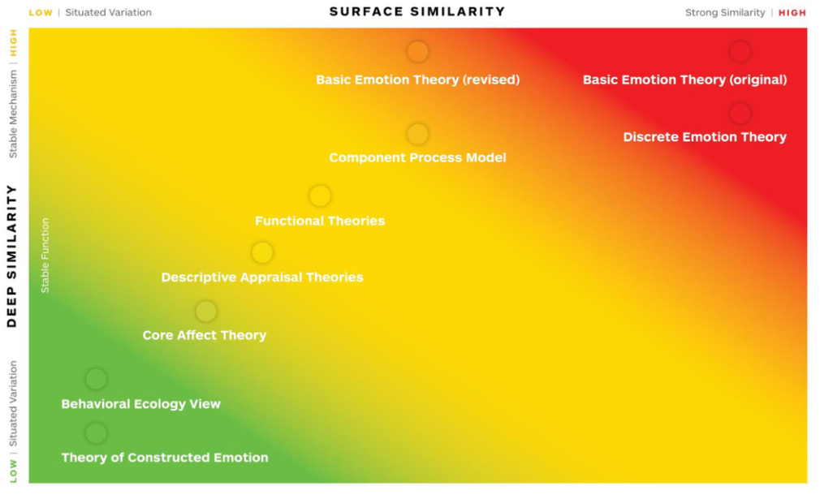
CONCEPTUAL BACKGROUND
Where theories differ: similarity and mechanism
Useful seminar framing
High surface similarity: instances look alike.
High deep similarity: instances share causal mechanisms.
The common view assumes strong enough similarity to make faces diagnostic.
Source: Barrett et al. (2019), Fig. 1
Barrett et al. (2019) | Affective computing seminar
9
Notes:
Timing: 3 minutes. Use Figure 1 to separate theoretical debates from the practical question. The paper does not require settling all emotion theory. It asks whether the evidence supports the face-emotion mapping consumers use.

Slide 10
INFERENCE
Forward inference is easier than reverse inference
p(face | emotion)
emotion episode
(e.g., anger)
facial movement
(e.g., scowl)
A face can have many causes. Reverse inference needs strong evidence, not just intuition.
observed face
(e.g., scowl)
inferred emotion
(e.g., anger)
p(emotion | face)
Barrett et al. (2019) | Affective computing seminar
10
Notes:
Timing: 3 minutes. Write the conditional probabilities on the board if useful. Explain why p(scowl | anger) can be nonzero while p(anger | scowl) is still weak. This is central to affective computing: most products make reverse inferences.

Slide 11
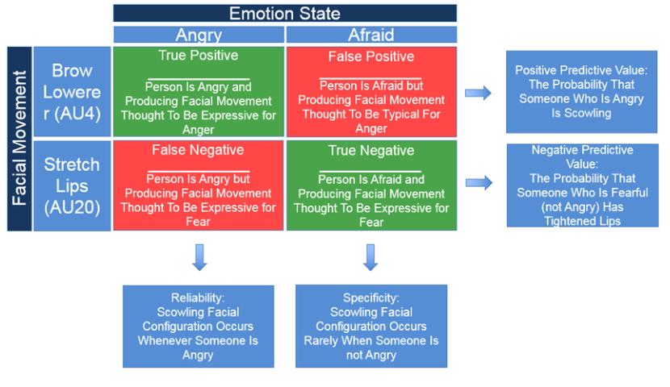
EVALUATION CRITERIA
Four criteria for a defensible inference
1. Reliability
Does the expected mapping occur often enough?
2. Specificity
Is the mapping unique to that emotion?
3. Generalizability
Does it replicate across people, cultures, contexts?
4. Validity
Was the person really in that emotional state?
Source: Barrett et al. (2019), Fig. 3
For high-stakes inference, above chance is not enough.
Barrett et al. (2019) | Affective computing seminar
11
Notes:
Timing: 4 minutes. Spend extra time here. Have students define each criterion in their own words. Emphasize that specificity is often missing from published studies and from model evaluation.

Slide 12
MEASUREMENT
Language can smuggle in conclusions
facial movement
facial configuration
emotional expression
descriptive
still descriptive
causal interpretation
FACS describes action units. It does not, by itself, say what emotion caused them.
Barrett et al. (2019) | Affective computing seminar
12
Notes:
Timing: 3 minutes. Highlight terminology discipline. A system that outputs AU12 + AU6 has detected a facial movement pattern; outputting happiness is an additional interpretive step.

Slide 13
MEASUREMENT
Automation helps measurement - and adds new risks
Ideal lab images
Different lab database
In the wild
>90% AU accuracy
~99% same database
~90% when conditions
remain controlled
<83% accuracy
F1 below .65
Front-facing, well-lit, posed faces are the easy case.
Unconstrained videos add occlusion, illumination, movement, culture, and context.
AU detection is still not emotion recognition.
Barrett et al. (2019) | Affective computing seminar
13
Notes:
Timing: 3 minutes. Use this as a bridge to affective computing. Even when AU detection improves, the harder claim is what those movements mean. This distinction helps separate computer vision performance from affective inference validity.

Slide 14
PART 2
Evidence I: producing facial movements
Do people actually move their faces in the stereotyped ways during emotion episodes?
Notes:
Section transition. Pause for 10 seconds and remind students where we are in the 80-minute arc. Do people actually move their faces in the stereotyped ways during emotion episodes?

Slide 15
PRODUCTION EVIDENCE
A typical production study
Induce
state
Measure
face
Measure
emotion
Compare
co-occurrence
Core challenge: emotion itself is hard to verify independently, so many studies rely on self-report, observer judgment, or researcher assumptions.
Barrett et al. (2019) | Affective computing seminar
15
Notes:
Timing: 2 minutes. Explain that production studies ask the forward-inference question: given an emotional episode, what facial movements occur? But the emotional episode must itself be identified somehow.

Slide 16
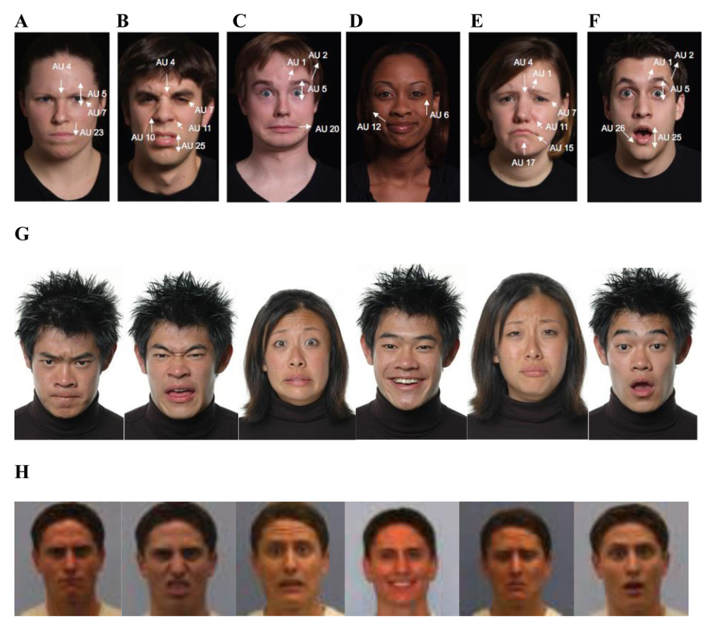
PRODUCTION EVIDENCE
The stereotyped faces under review
These images are useful as stimuli and cultural symbols. The paper asks whether they are diagnostic displays.
They are often posed or selected.
They exaggerate category differences.
They can shape participant expectations.
Source: Barrett et al. (2019), Fig. 4
Barrett et al. (2019) | Affective computing seminar
16
Notes:
Timing: 2 minutes. Use this slide to make the stimulus problem tangible. These are recognizable stereotypes, but recognizability is not the same as validity.

Slide 17
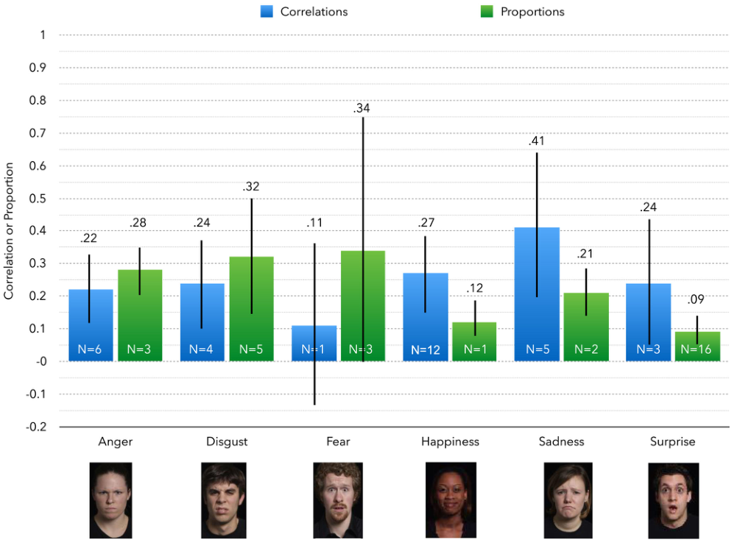
PRODUCTION EVIDENCE
Production evidence: above chance, but weak
Expanded meta-analysis: average r around .32; average proportion around .19.
Interpretation: faces sometimes match stereotypes, but more often they do not.
Source: Barrett et al. (2019), Fig. 5
Barrett et al. (2019) | Affective computing seminar
17
Notes:
Timing: 4 minutes. Walk through the y-axis and the emotion categories. Ask: would this be sufficient for a deployed classifier that claims to know a student, defendant, driver, or patient is angry or sad?

Slide 18
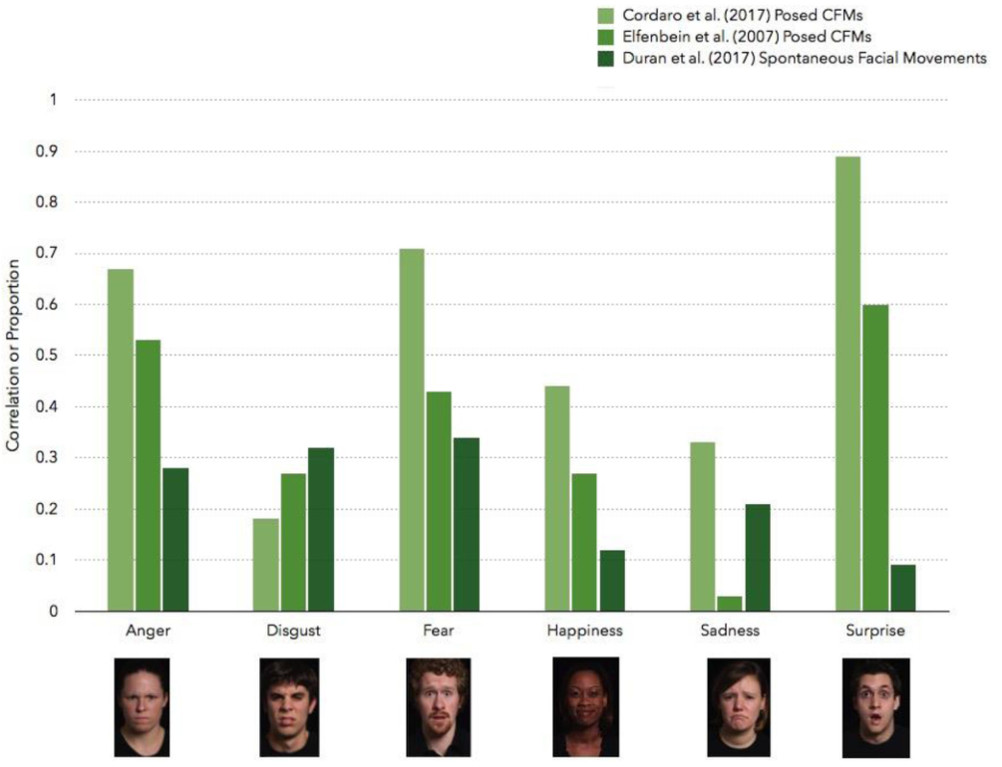
PRODUCTION EVIDENCE
Posed expressions are not spontaneous expressions
Posing captures beliefs and display skills.
Spontaneous movement captures situated behavior.
Treating posed faces as ground truth risks training stereotypes.
Source: Barrett et al. (2019), Fig. 6
Barrett et al. (2019) | Affective computing seminar
18
Notes:
Timing: 4 minutes. This is a key affective computing slide. Many datasets use posed labels. The figure shows that posed configurations can look more regular than what people do in actual episodes.

Slide 19
PRODUCTION EVIDENCE
Naturalistic smiles: social signals, not readouts
winning
match
reported
happiness
Duchenne
smile
audience
interaction
Judo winner studies: smiles were better predicted by social interaction with an audience than by reported happiness.
Barrett et al. (2019) | Affective computing seminar
19
Notes:
Timing: 3 minutes. This is a memorable example. The point is not that winners were not happy, but that the smile was not a simple meter of happiness. Social context better explained the movement.

Slide 20
PRODUCTION EVIDENCE
Converging production evidence
Small-scale remote cultures
No systematic production studies of spontaneous emotional episodes; evidence is inconclusive.
Infants and children
Movements often signal distress, arousal, or approach/avoidance; reliability and specificity for categories are weak.
Congenitally blind individuals
Spontaneous facial movements are variable; posed movements differ, suggesting learning and convention.
Across populations, the theme is variability rather than diagnostic universality.
Barrett et al. (2019) | Affective computing seminar
20
Notes:
Timing: 4 minutes. This slide condenses several sections of the paper. Emphasize that these populations are important tests of universality: infants, remote cultures, and congenitally blind individuals.

Slide 21
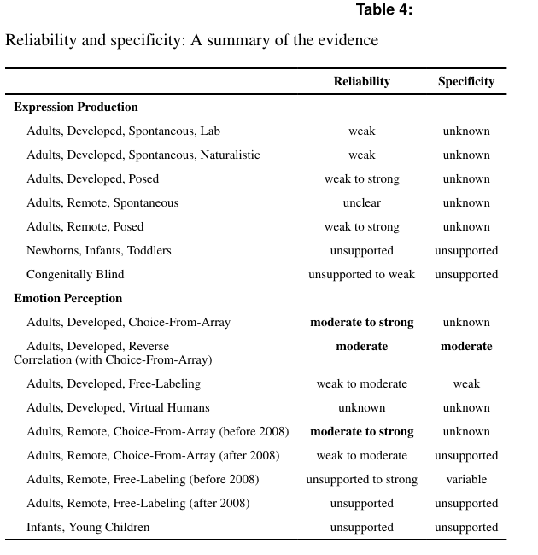
PRODUCTION EVIDENCE
Production summary: no fingerprint
Best summary
Spontaneous production: weak or unsupported reliability.
Specificity: often unknown or unsupported.
Posed production: stronger, but not the same phenomenon.
Neutral vocabulary is safer: facial movements, not emotional expressions.
Source: Barrett et al. (2019), Table 4
Barrett et al. (2019) | Affective computing seminar
21
Notes:
Timing: 3 minutes. Use this slide to close production evidence. Say clearly: the paper does not claim faces are meaningless. It claims the common view is not supported strongly enough for diagnostic inference.

Slide 22
PART 3
Evidence II: perceiving emotion in faces
Do observers reliably and specifically infer the same emotion from the same facial movement?
Notes:
Section transition. Pause for 10 seconds and remind students where we are in the 80-minute arc. Do observers reliably and specifically infer the same emotion from the same facial movement?

Slide 23
PERCEPTION EVIDENCE
Recognition or agreement?
posed actor
not necessarily emotional
participant
chooses a label
researcher calls it
recognition accuracy
Without independent ground truth, this is agreement with a label - not proof that the face revealed an emotion.
Barrett et al. (2019) | Affective computing seminar
23
Notes:
Timing: 3 minutes. This is the central critique of perception studies. Emphasize that posed photographs cannot validate accuracy because the person in the photograph is often not feeling the target emotion.

Slide 24
PERCEPTION EVIDENCE
Choice-from-array tasks can inflate agreement
Task prompt
Which emotion is this?
Allowed answers
anger | sadness | fear | happiness
Observed result
more common-view labels
Response options exclude many plausible meanings: confusion, threat, pain, politeness, effort.
Emotion words can prime what participants see or learn during the task.
The task can become elimination based on valence or arousal.
Barrett et al. (2019) | Affective computing seminar
24
Notes:
Timing: 4 minutes. Ask students to imagine a multiple-choice exam where only one answer is pleasant. Discuss how task structure can make a participant look more knowledgeable than they are.

Slide 25
PERCEPTION EVIDENCE
The method changes the conclusion
constrained
less constrained
open-ended
choice-from-array
reverse correlation / similarity
free labeling
Moderate to strong agreement
for stereotyped labels
More variability
and similarity among categories
Weak to moderate reliability
and weak specificity
Barrett et al. (2019) | Affective computing seminar
25
Notes:
Timing: 3 minutes. This slide conveys the core pattern in perception evidence. Stronger support for the common view tends to appear when the task is most constrained.

Slide 26
PERCEPTION EVIDENCE
Many-to-many mappings in open labeling
17
A single emotion word can be associated with multiple distinct facial configurations.
A single facial configuration can be associated with more than one emotion or social meaning.
5
4
4
2
1
happiness
anger
sadness
surprise
fear
disgust
distinct facial configurations associated with label
Counts from Srinivasan & Martinez (2018), summarized by Barrett et al. (2019).
Barrett et al. (2019) | Affective computing seminar
26
Notes:
Timing: 3 minutes. Use the chart to reinforce many-to-many mapping. Happiness is especially salient because datasets often have one smiling prototype, but natural images show many different configurations associated with happy words.

Slide 27
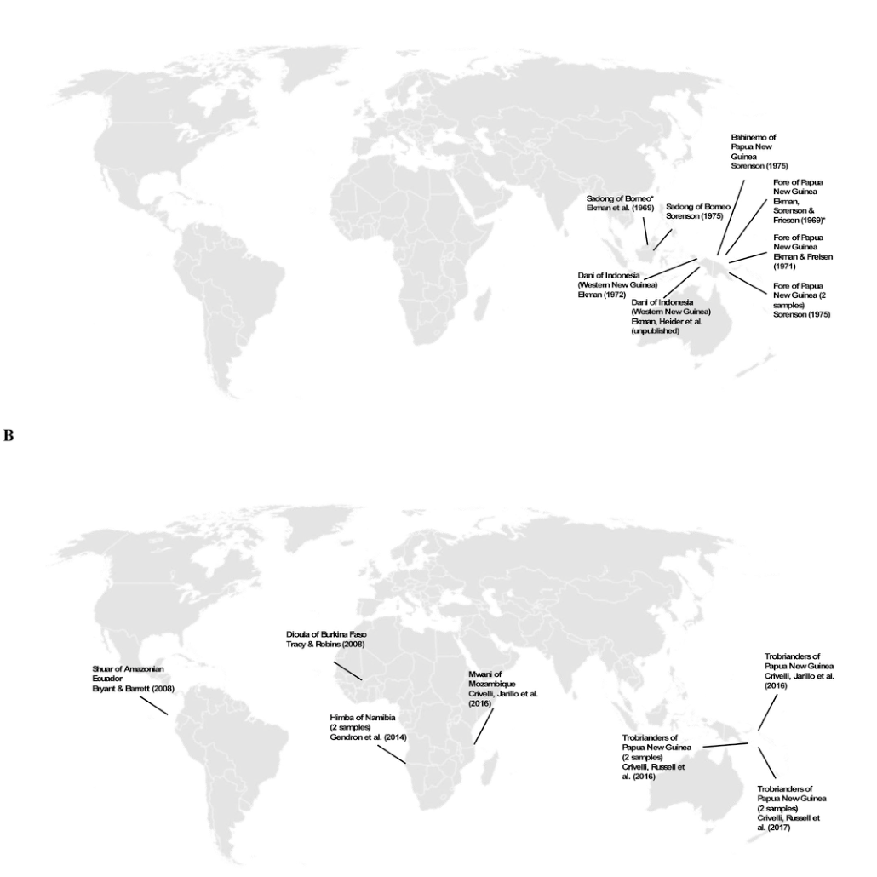
PERCEPTION EVIDENCE
Cross-cultural evidence complicates universality
Older studies relied heavily on South Pacific samples and choice-from-array tasks.
Newer studies sampled broader ecological contexts and used less constrained methods.
Findings often support valence or social/action meanings more than universal emotion categories.
Source: Barrett et al. (2019), Fig. 9
Barrett et al. (2019) | Affective computing seminar
27
Notes:
Timing: 4 minutes. Explain why remote and small-scale societies matter for universality claims. Mention that the wide-eyed gasping face can be interpreted as threat or aggression in some contexts.

Slide 28
PERCEPTION EVIDENCE
Development: children learn situated meanings
valence
pleasant / unpleasant
arousal
activated / calm
context
body, voice, situation
concepts
words and categories
Emotion perception is not simply switched on at birth; it develops through social experience.
Barrett et al. (2019) | Affective computing seminar
28
Notes:
Timing: 3 minutes. Briefly cover infant and child evidence. Stress that young children may use context more explicitly than adults in some tasks, and early experience changes attention to threat cues.

Slide 29
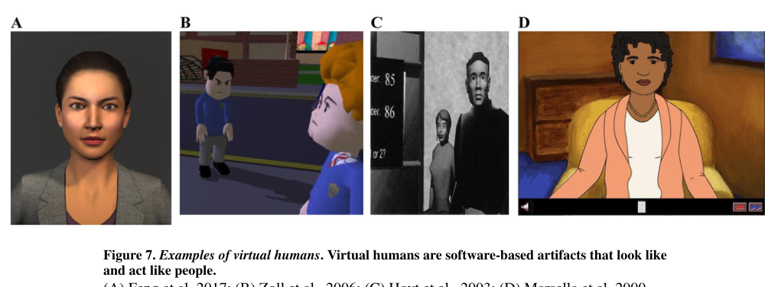
PERCEPTION EVIDENCE
Virtual humans: a bridge to affective computing
Source: Barrett et al. (2019), Fig. 7
Virtual agents can manipulate timing, context, and contingency with experimental control.
They show that the same smile can mean cooperation or competition depending on situation.
They can be used to study inference mechanisms instead of merely animating stereotypes.
Barrett et al. (2019) | Affective computing seminar
29
Notes:
Timing: 3 minutes. This slide connects to graduate-level affective computing: virtual humans are not just applications, they can be methodological tools for studying context-sensitive inference.

Slide 30
PART 4
Implications for affective computing
The target variable matters as much as the model architecture.
Notes:
Section transition. Pause for 10 seconds and remind students where we are in the 80-minute arc. The target variable matters as much as the model architecture.

Slide 31
COMPUTING IMPLICATIONS
From face reading to situated inference
facial
actions
situation
probabilistic
situated model
prediction
with uncertainty
voice
+
culture
->
->
body
history
Recommended shift: detect observable behavior; infer psychological meaning only when context and evidence justify it.
Barrett et al. (2019) | Affective computing seminar
31
Notes:
Timing: 3 minutes. This slide translates the paper into a design philosophy. Facial action detection can be one input; emotion inference should be probabilistic, contextual, and explicit about uncertainty.

Slide 32
COMPUTING IMPLICATIONS
Dataset audit: before you train a model
Label source
Self-report, observer consensus, scenario, actor prompt, or app metadata?
Stimulus ecology
Static or dynamic? Posed or spontaneous? Face alone or whole scene?
Population
Whose faces, languages, cultures, ages, and contexts are sampled?
Negative evidence
Are false positives and specificity reported?
Ground truth claim
Does the dataset justify emotion labels, or only facial-action labels?
Barrett et al. (2019) | Affective computing seminar
32
Notes:
Timing: 4 minutes. Treat this as a practical checklist. You can ask students to apply it mentally to a dataset they have used, such as FER-style posed images or videos with crowd labels.

Slide 33
COMPUTING IMPLICATIONS
Model evaluation: accuracy is not enough
Reliability
Does the model make the same inference under legitimate variation?
Specificity
How often does it infer anger from non-anger situations?
Generalizability
Does performance transfer across context, culture, age, lighting, and task?
Validity
Is the label measuring emotion, behavior, social signal, or task consensus?
Report uncertainty and abstain when the evidence is insufficient.
Barrett et al. (2019) | Affective computing seminar
33
Notes:
Timing: 3 minutes. Tie the four criteria back to ML evaluation. Stress false positives and out-of-distribution generalization. Ask what a confusion matrix misses when the labels themselves are questionable.

Slide 34
COMPUTING IMPLICATIONS
Deployment: choose claims that match the evidence
Safer claim
Risky claim
Detect facial actions or movement patterns.
This person is angry, lying, unsafe, engaged, or remorseful.
Flag possible states for human review.
The face alone establishes an internal state.
Use in low-stakes creative interfaces.
The same mapping holds across all people and contexts.
High-stakes settings demand higher evidence because errors affect real outcomes.
Barrett et al. (2019) | Affective computing seminar
34
Notes:
Timing: 3 minutes. Discuss the difference between applications that manipulate faces for communication and applications that infer mental states. The first may not need emotion truth; the second does.

Slide 35
COMPUTING IMPLICATIONS
Research agenda: build a science of situated signals
deep
sampling
multimodal
measures
context
annotation
person-level
models
valid
translation
Sample individuals across situations and time, not just many isolated faces.
Synchronize face, body, voice, physiology, task, and environment.
Use virtual humans for controlled, interactive, context-rich experiments.
Barrett et al. (2019) | Affective computing seminar
35
Notes:
Timing: 4 minutes. Present this as a constructive ending. The paper is not anti-computation; it calls for better computational science: higher-dimensional, contextual, dynamic, and person-sensitive.

Slide 36
Seminar activity
Audit a face-emotion classifier
In small groups, choose a real or hypothetical system and answer:
1
What exactly is detected? What exactly is inferred?
2
What is the label source, and what does it make valid?
3
Where would false positives be most harmful?
4
What extra context would reduce ambiguity?
5
Should the system abstain, explain, or hand off to a human?
Notes:
Timing: 8 minutes. Put students in groups of 3-4. Ask each group to audit a system: classroom engagement detector, interview screening, driver monitoring, therapy robot, or surveillance. Leave 2 minutes for report-out.

Slide 37
WRAP-UP
Five takeaways
1
Faces are informative, but not standalone emotion fingerprints.
2
Above-chance reliability is not enough for reverse inference.
3
Specificity and validity are often missing from the evidence base.
4
Task design, labels, and culture shape apparent recognition.
5
Affective computing should model situated, multimodal, uncertain meaning.
Best one-sentence summary: do not ask a face alone to answer a question that requires a situation.
Barrett et al. (2019) | Affective computing seminar
37
Notes:
Timing: 3 minutes. Close with the practical principle. Invite final questions about whether there are specific applications where a narrower facial-action target is appropriate.

Slide 38
SOURCES
References and suggested reading
Barrett, L. F., Adolphs, R., Marsella, S., Martinez, A. M., & Pollak, S. D. (2019). Emotional Expressions Reconsidered. Psychological Science in the Public Interest, 20(1), 1-68.
Barrett, L. F. (2017). How Emotions Are Made. Houghton Mifflin Harcourt.
Jack, R. E., & Schyns, P. G. (2017). Toward a social psychophysics of face communication. Annual Review of Psychology.
Srinivasan, R., & Martinez, A. M. (2018). Cross-cultural and cultural-specific production and perception of facial expressions in the wild.
Slide figures are adapted from the assigned Barrett et al. article for classroom use.
Source deck generated from the uploaded article
38
Notes:
Timing: reserve for after discussion or skip during live presentation. Include this slide for students who want to follow up.

